Slide 1
Predicting NBA Playoffs with Machine Learning
IST 707: Machine Learning Final Project
Emani Jones, Casey Walsh, Daniel Eaton, Seyed Alireza Zarrin Mehr
Notes:
In this project we are going to work on NBA data set which is scrapped from NBA website.
The objective is predicting the outcome of the matches that could satisfy business cases

Slide 2
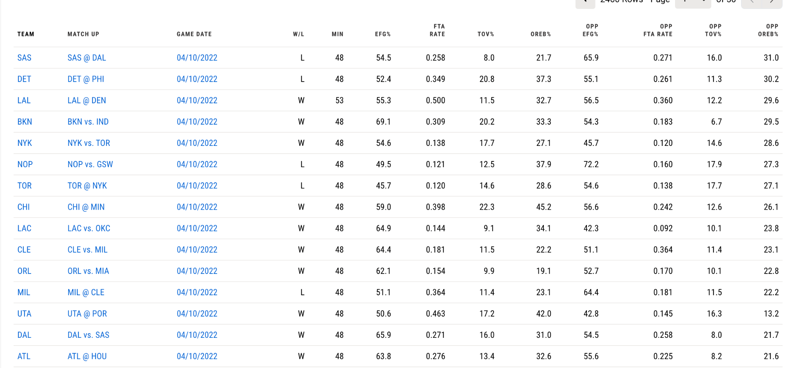
The Data
The NBA stats page has advanced box scores for every playoff game data back from the 1996-1997 season. Using the NBA python API, we can scrap these advanced box scores from the NBA page.
Notes:
The data set is a longitudinal which will allow us to use the historical data.
We are going to use historical data to figure out how each team performed in the past.
We will also use the historical live data to predict the match result half way through the game.

Slide 3
Cleaning the Data
Scraped data from NBA API
Calculated features
Home Court Advantage
Rolling averages of Four Factors of Success
Mean Value Over Replacement Players by team and year

Slide 4
Multiple Linear Regression
Model
Created a multiple linear regression using the win percentage as the dependent variable
Started with all the variables in the data, then created a stepwise regression to include only significant predictors
Accuracy
RMSE Rsquared MAE
0.0716 0.7869 0.0497

Slide 5
Multiple Logistic Regression
Model
Created a logistic regression model to predict the probability that the team wins a game
Stepwise model
Accuracy
Accuracy Kappa
0.6883 0.3766
Pseudo Adjusted R Squared: 0.165

Slide 6
Models - Naïve Bayes and kNN
Naïve Bayes
Accuracy - 68.4%
Data formatted for use with the model, no other tuning yet performed
kNN
Accuracy - 68.1%
k = 10

Slide 7
Models - Random Forest and Neural Network
Model Set Up
Features: Season Type, Home Advantage, Win Loss Lag, EFG Percent Lag, FTA Rate Lag, Team Turnover Percent Lag, Offensive Rebound Percent Lag, Opponent EFG Percent Lag, Opponent FTA Rate Lag, Opponent Turnover Percent Lag, and Opponent Offensive Rebound Percent Lag(11 features total)
Target: W/L
Removed rows with missing data (removed about 10,000 rows of a data set with 65,000+ rows)
Random Forest
50 trees - 0.681 F1, Precision, and Recall
100 trees - 0.683 F1, Precision, and Recall
Neural Network
50 neurons - 0.689 F1, Precision, and Recall
100 neurons - 0.688 F1, Precision, and Recall

Slide 8
Models-Random Forest and NN after hyper tuning
Random Forest(after tuning)
Tuning possibilities: Number of trees, number of features to consider at every split, and the maximum number of levels within the tree (depth).
Unfortunately, all tuning only decreased/increased the F1 score by extremely minimal amounts.
Neural Network(after tuning)
Tuning possibilities: Number of hidden layers, number of neurons in each hidden layer, and the regularization rate.
Optimal layers: 3
Neurons per layer: 11,7,2 respectively
0.694 F1, Precision, and Recall

Slide 9
Clustering the Players

Slide 10
Data preprocessing:
The data has got scraped from the basketball references website
(https://www.basketball-reference.com/leagues/NBA_)
Number of positions has got decreased to 5 main positions to reduce dimensionality.
For Example:
SG-SF | PF-C | SG-PG | SF-SG | SF-C | SG-PG-SF
1 | 0 | 0 | 0 | 0 | 0
0 | 0 | 0 | 0 | 0 | 1
SG | PG | SF | C | PF
1 | 0 | 1 | 0 | 0
1 | 1 | 1 | 0 | 0

Slide 11
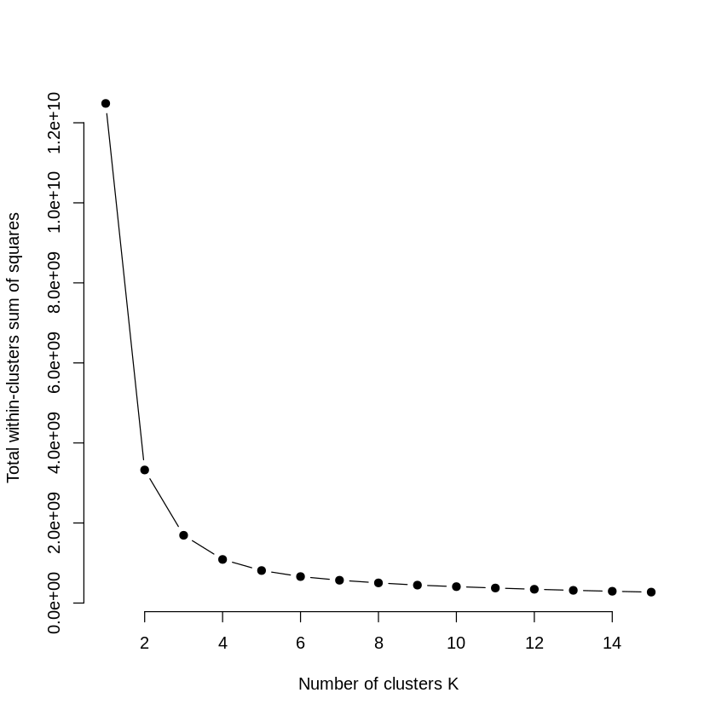
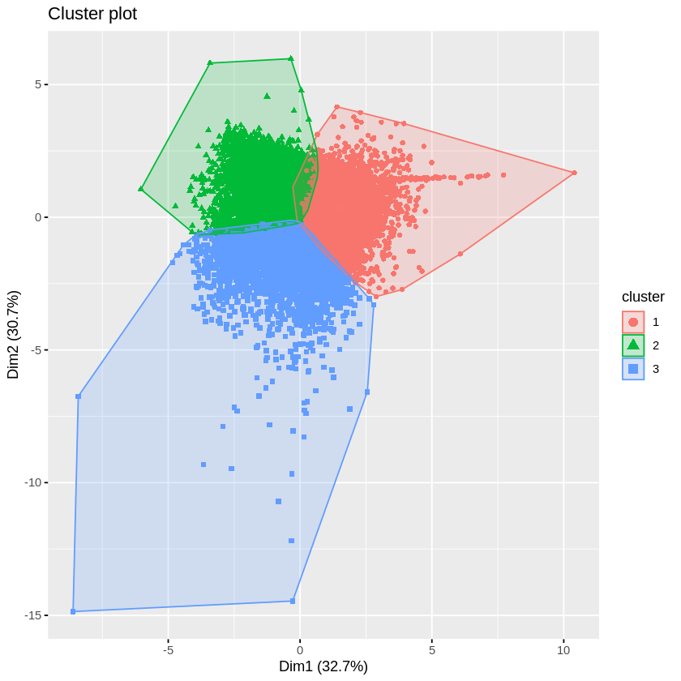
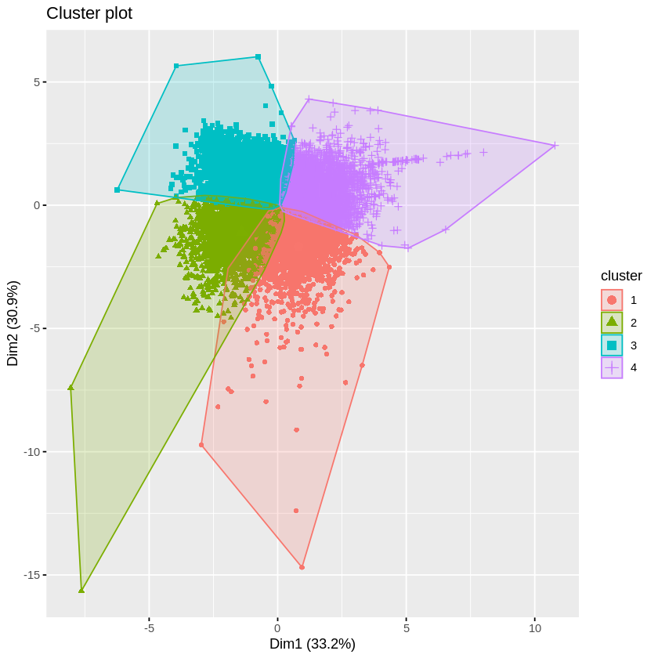
How Many Clusters :
Clustering the players to 3 clusters:
Less overlap
Clustering the players to 4 clusters:
More overlap
Using the Elbow method we found that 3 or 4 clusters will yield the best results:

Slide 12
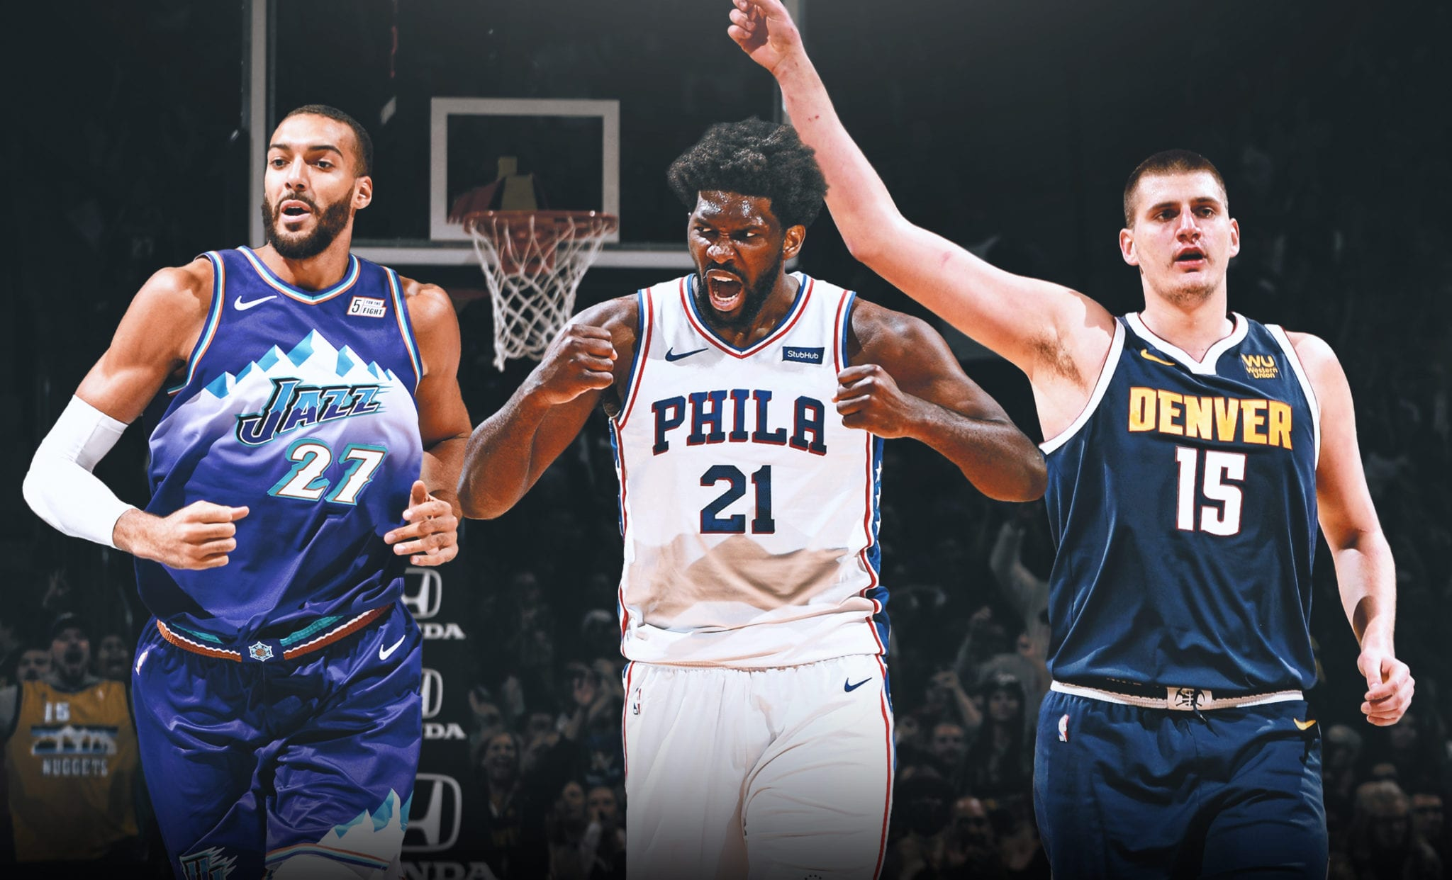
Cluster 3 Big Men
Mainly Power forwards and centers
Lower 3 Point Rate
Higher rebounding and block rate

Slide 13
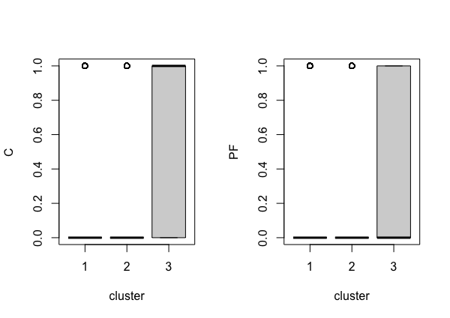
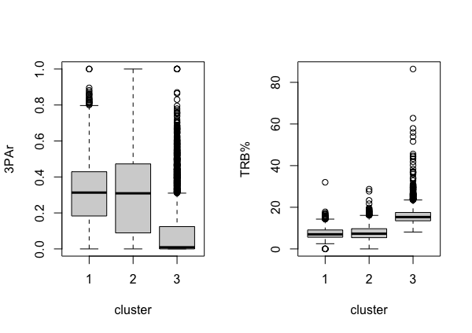
C - Center
PF - Power Forward
TRB% -- Total Rebound Percentage
An estimate of the percentage of available rebounds a player grabbed while they were on the floor.
3PAr -- 3-Point Attempt Rate
Percentage of FG Attempts from 3-Point Range

Slide 14
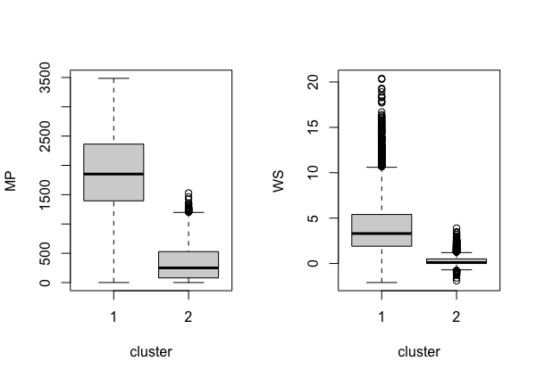
Cluster 1 (Superstars and Stars) & Cluster 2 (Role Players and Bench)
Mostly guards and Wing Players
There is not much of a difference between the playing styles of the two clusters
The difference lies in the Minutes Played and Win Shares of the Players
WS -- Win Shares
An estimate of the number of wins contributed by a player.
MP -- Minutes Played

Slide 15
How the Clusters Affected Our Models

Slide 16
Regression Models
Logistic Regression
All 3 cluster where significant predictors
Performed better than the previous model
RMSE Rsquared MAE
0.0682 0.807 0.0462
Logistic Regression
The clusters were not significant predictors
No change in the performance of the models
Accuracy Kappa
0.6886 0.3771
Pseudo Adjusted R Squared: 0.165

Slide 17
Models - Random Forest and Neural Network after additional data
Model Set Up
Features: Season Type, Home Advantage, Win Loss Lag, EFG Percent Lag, FTA Rate Lag, Team Turnover Percent Lag, Offensive Rebound Percent Lag, Opponent EFG Percent Lag, Opponent FTA Rate Lag, Opponent Turnover Percent Lag, and Opponent Offensive Rebound Percent Lag, Rating, Mean VORP, Mean BPM, Cluster 1-Superstars/stars, Cluster 2-Role players/bench players, Cluster 3-Big men (17 features total)
Target: W/L
Removed rows with missing data (removed about 10,000 rows of a data set with 65,000+ rows)
Model performance
Random Forest Regressor: 0.669 F1, Precision, Recall
Neural Network(10,5,2): 0.692 F1, Precision, Recall

Slide 18
Models - Naïve Bayes and kNN
Naïve Bayes
Accuracy - 66.4% (-2%)
kNN
Accuracy - 63.2% (-4.9%)
k = 10

Slide 19
Future Scope
Breaking down the data by decades or era
Is 3 point shooting more conducive to winning now, than it was in the 90s
Using a different number of clusters
Possibly allowing for more overlap

